Slide 1
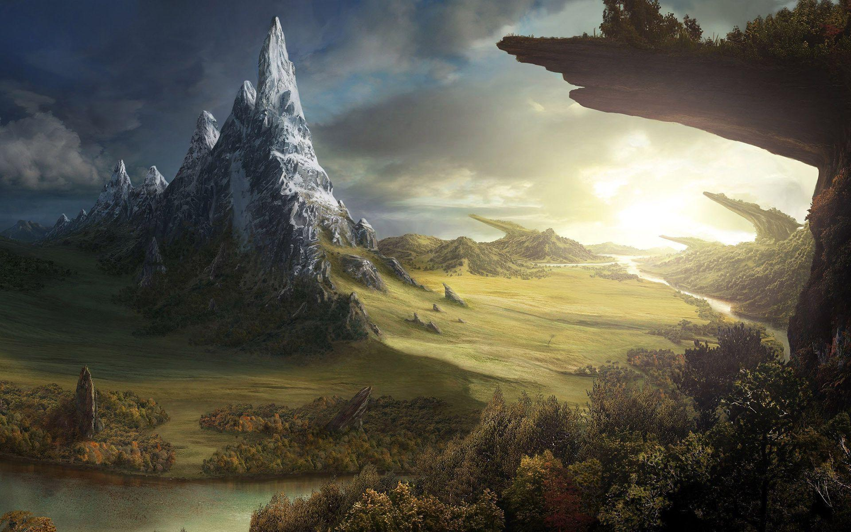


Power
By: Dylan R.
VGDDT Class
2018-10-23

Slide 2
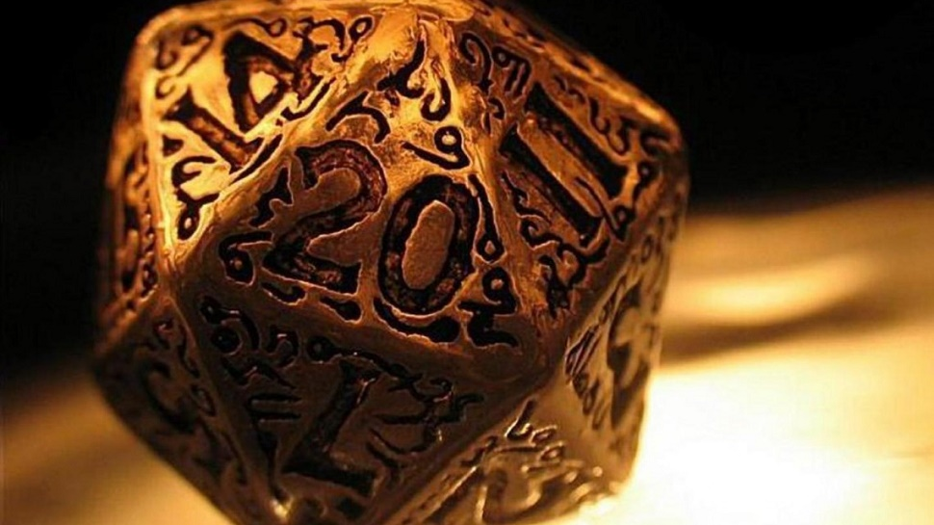
Table of Contents
Story
Objective
Gameplay
Additional Information
Selling Points
Requirements

Slide 3
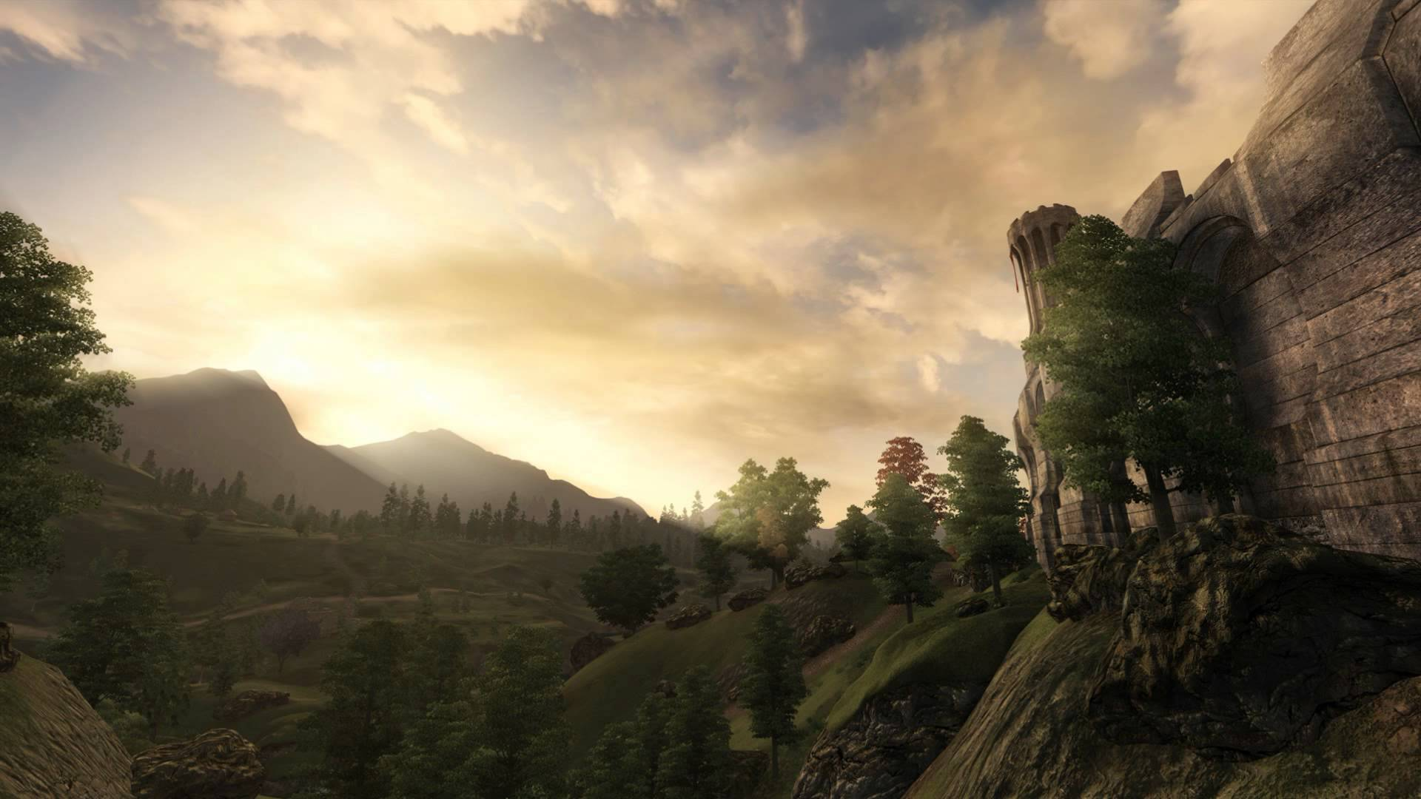
High Concept
Help Hafur find his way to power and glory. Which path will you choose to gain strength? Between magic, combat and stealth all these kills will help you get to the height of godhood.

Slide 4
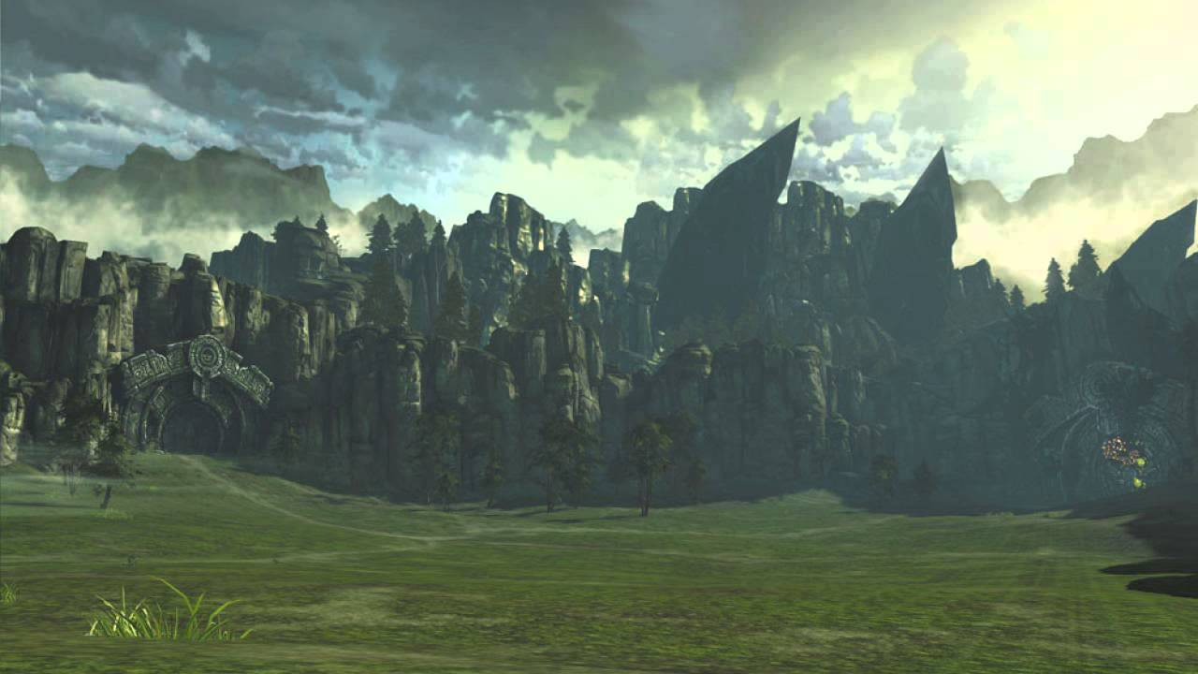

Story
In a world of mythical creatures, magic and war, you play as a traveller named Hafur. Hafur travels the world in search of items of power. You play as Hafur, helping him in his quest for items left over from the first kingdom to colonize the land. Throughout his adventure you fight, jump, run and climb your way through various caves, dungeons and forests. Along the way you will meet some interesting folks of the land. Some simple merchants, some in need of a favour for rewards and others looking to fuel their bloodlust. While playing as Hafur you may notice his decisions becoming a little more unfair and even cruel at some points. When you collect all. the items of power and reach the end of the main storyline it is revealed that Hafur -the character the player has been playing- was the true villain all this time and the items of power had given him the strength to conquer the world.

Slide 5
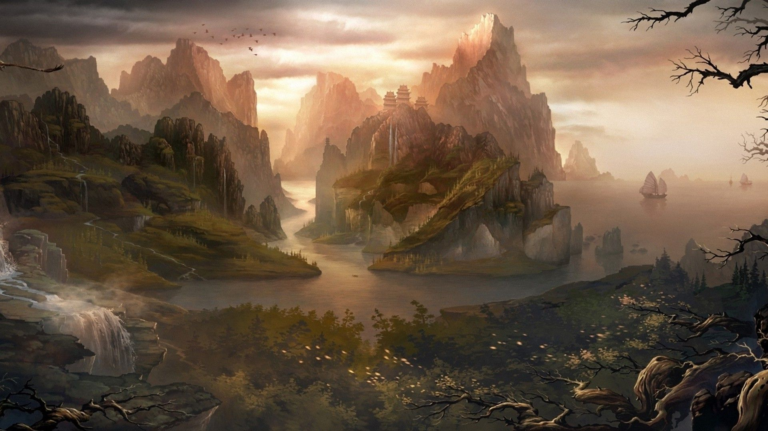

Objectives
Obtain the item of power which will be guarded by “Generals of The Dark Hell-King”.
Build a small army of allies you help along the way.
Find the alter where the items of power will be used to unleash their full power for Hafur.

Slide 6
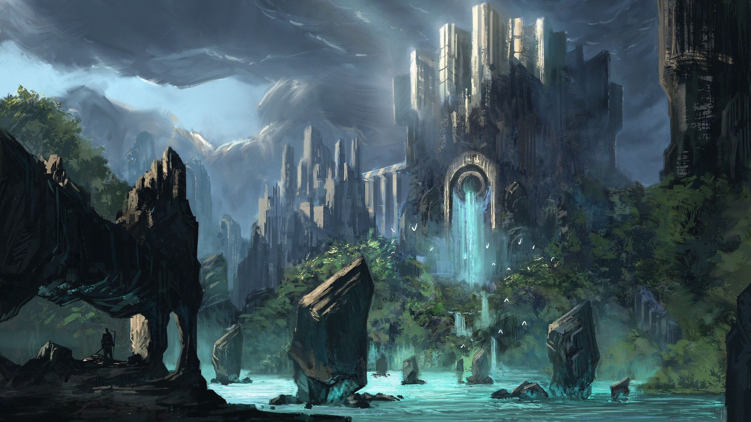

Gameplay
GUI will be similar to Earlier Skyrim and Assassin’s Creed: Origins
Gameplay elements similar to Assassin’s creed, Styx & Witcher
Story elements will feel more like Elder Scrolls
Different playstyles with Magic, Stealth and Combat

Slide 7

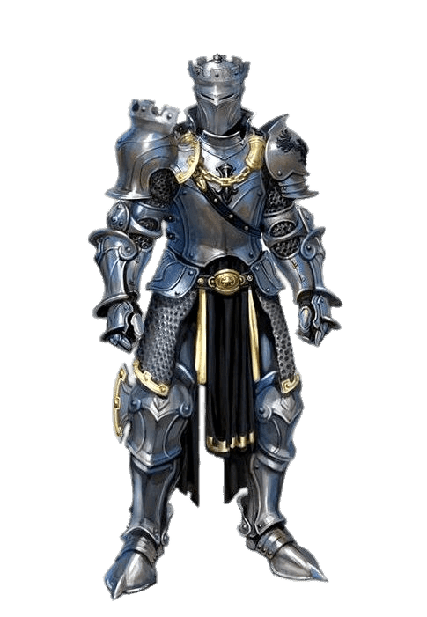

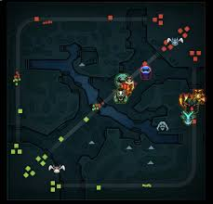
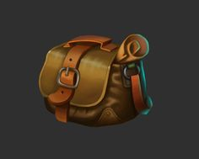

Find the Secret doorway
12

Slide 8





Additional Information
PS4/PRO, XBOX ONE/X, PC
A game more for serious gamers but easy for newcomers to learn
Rating T (Teens)

Slide 9
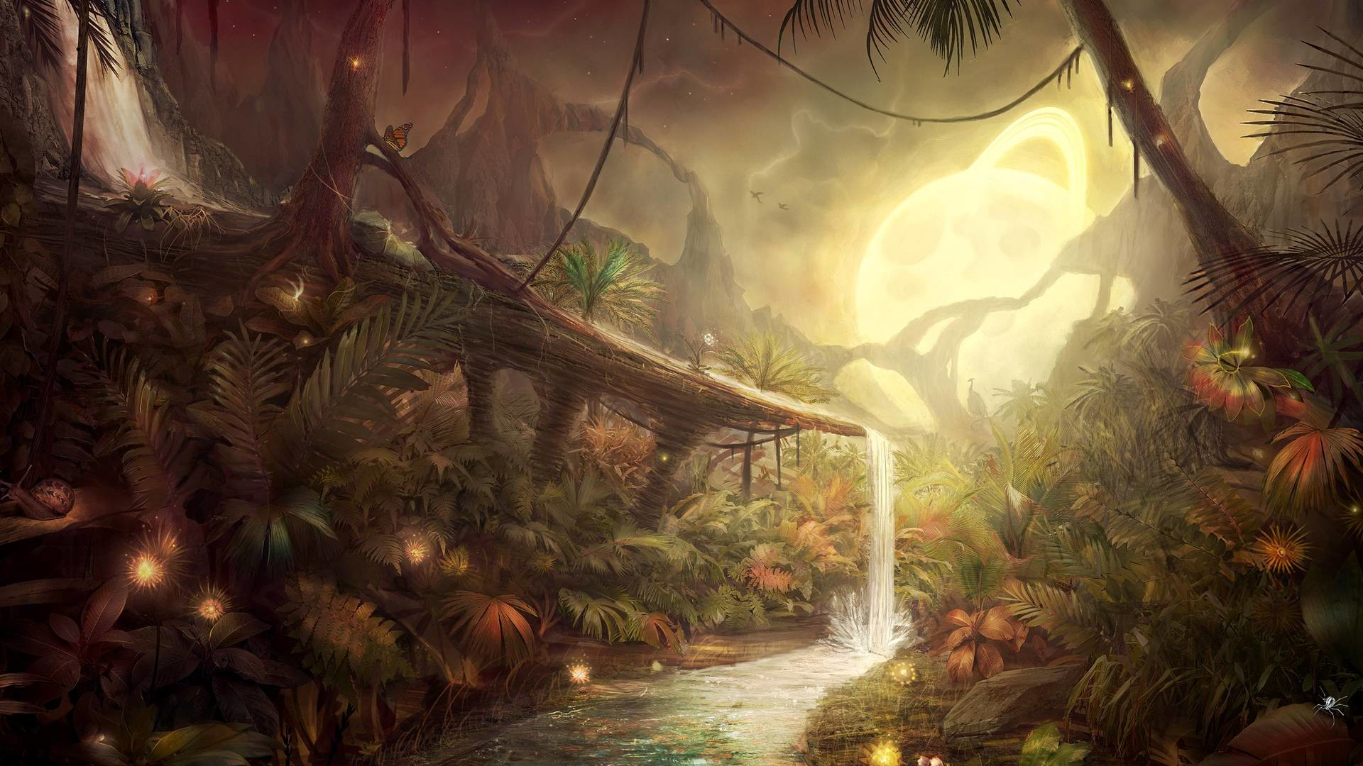

Selling Points
Open world RPG’s are making good business in the industry
Deep story to delve into and plenty of side quests will offer more for the player to do eve after beating the main story
Options of Stealth, Magic and Combat offer a wide range of different playstyles

Slide 10
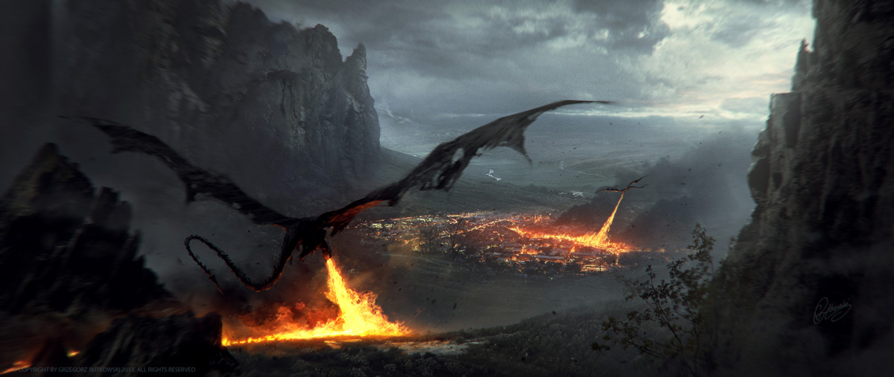

Requirements
Game will take around 8-12 months to produce. Consisting of 2 designers, 6 programmers, 3 artists, 2 illustrators, 2 sound engineer and 1 producer.
300,000 investment needed
Sale goal 1 million copies
Product price $60 USD

Slide 11
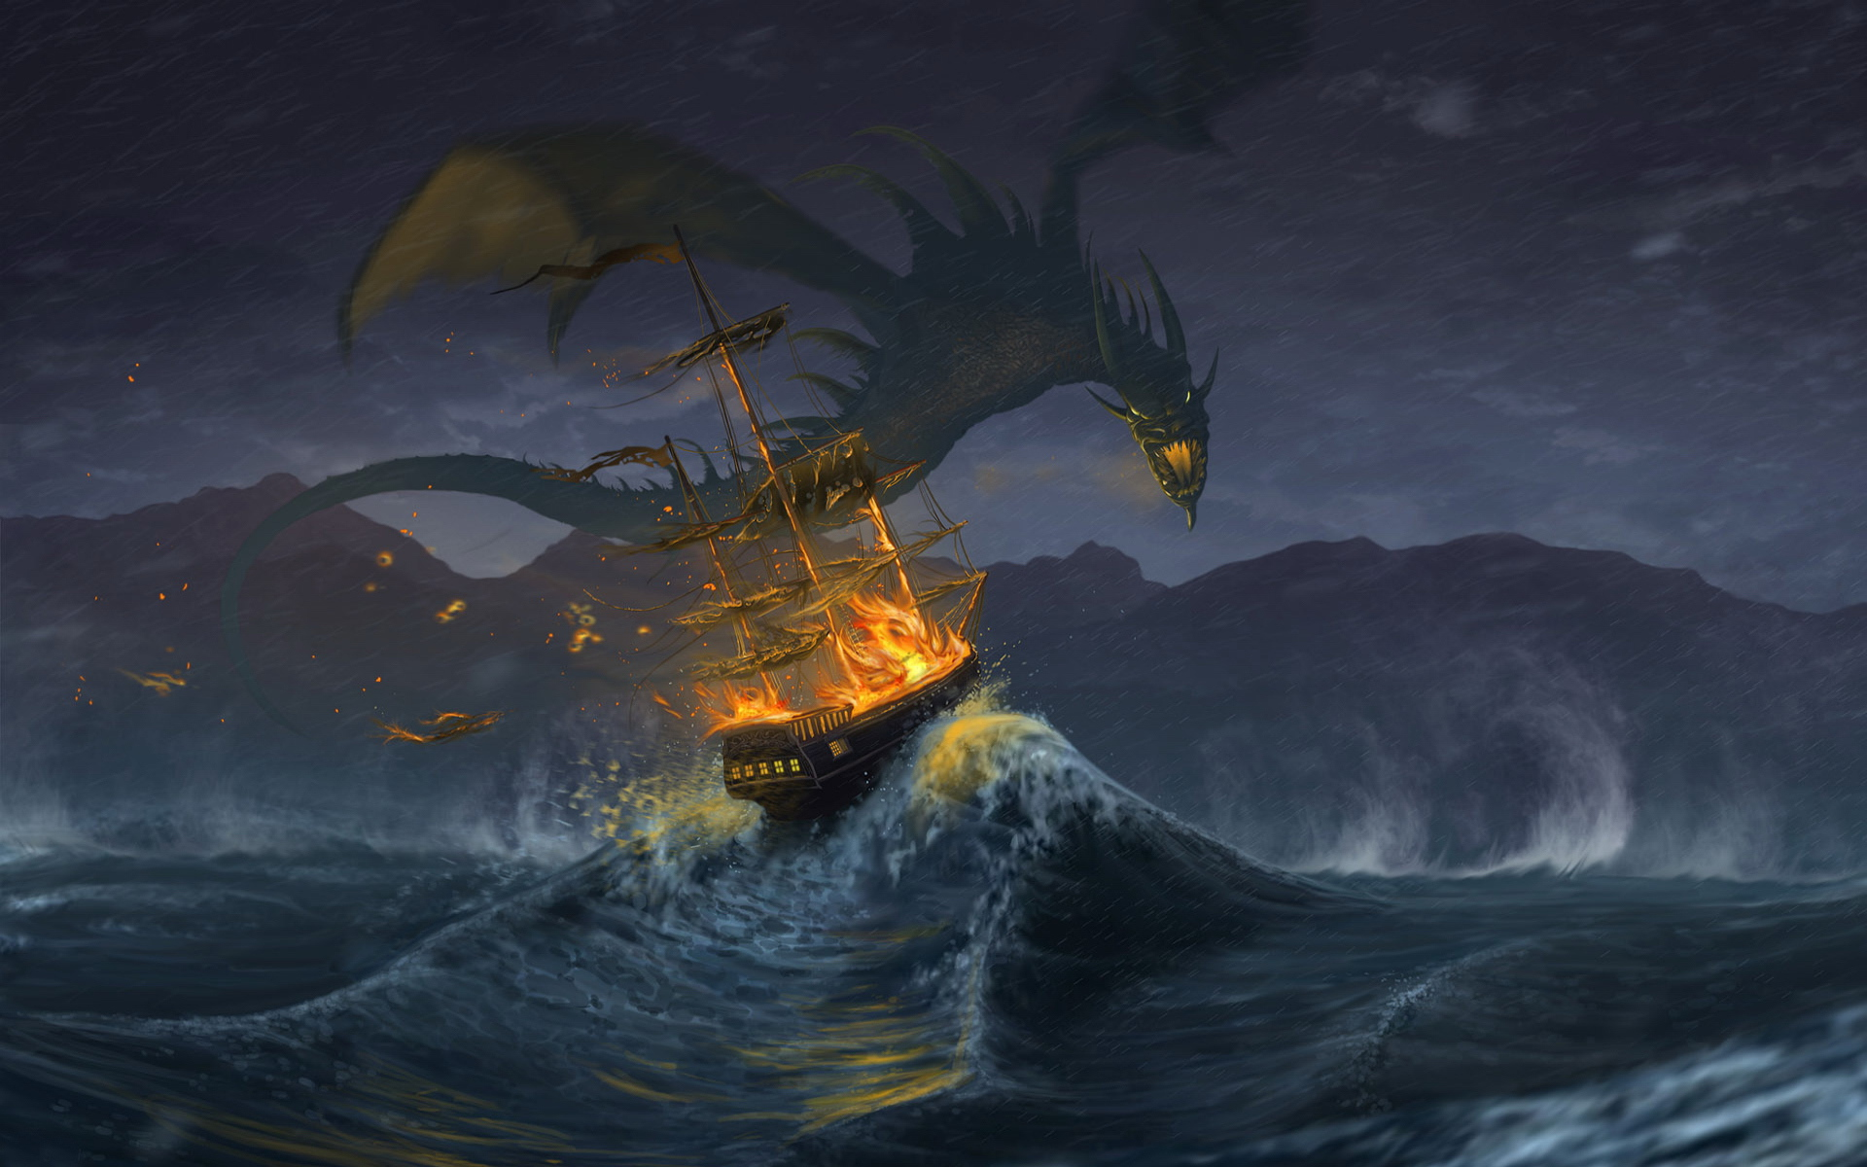
Summary
Story is about a man who you unknowingly help take over the world
Gameplay is easy to pick up but challenging depending on the level
Condole and PC
Open world, RPG

Slide 12
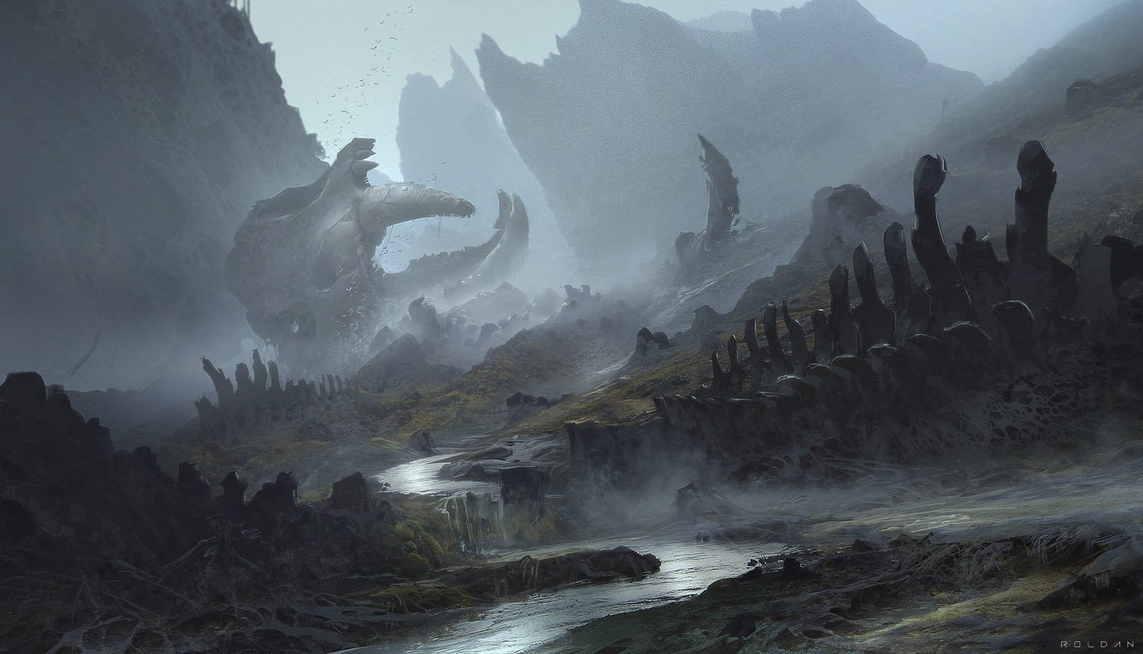
Thank you Any Questions?

